Slide 1
Inventory Management & Optimisation
DATA-DRIVEN SUPPLY CHAIN MANAGEMENT AND LOGISTICS · CASE STUDY
Half the capital in stock, better availability: data analysis, article classification and new safety stock and reorder points
Nikolaos Georgantopoulos · [Colleague name] · Master in Information Management and Data Science, HSLU
Notes:
PRESENTER: Colleague. Time: 30 seconds. Good morning. We present our case study on inventory management and optimisation. The company in the case has tied up more and more money in stock since 2018. In the next 17 minutes we show where that money sits, which articles should be kept in stock at all, and how much stock the remaining articles need. The headline: capital tied up in stock can fall by 55 percent, while availability in our test even rises. Structure: I present the situation, the data and the main findings. Niko then explains the classification and the safety stock and reorder point method. I close with the result and our recommendations.

Slide 2
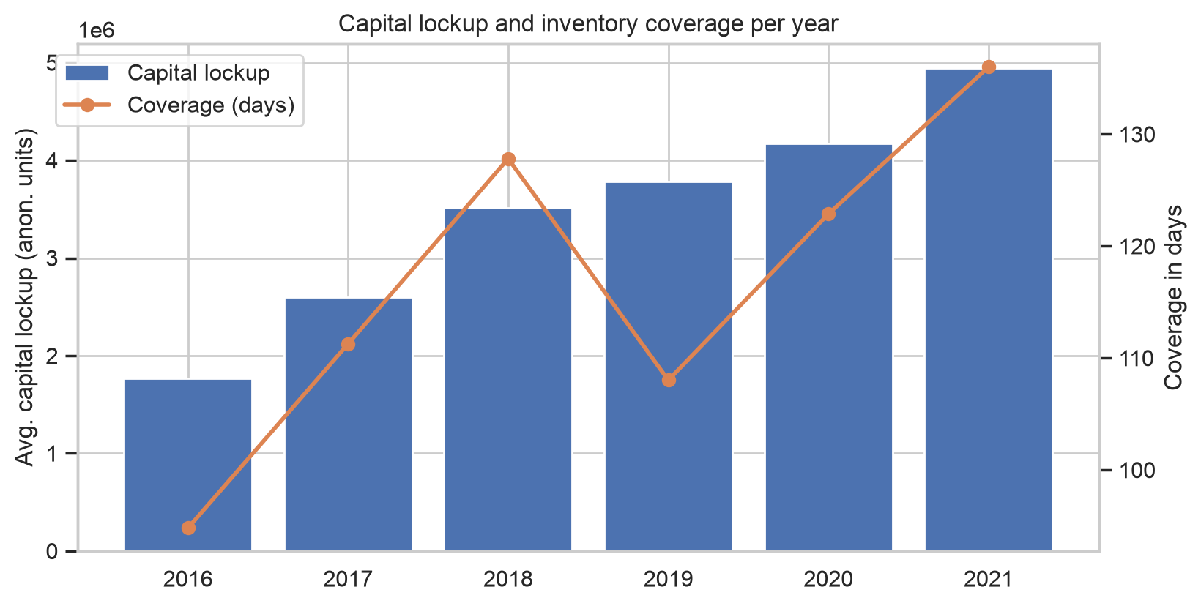
Stock was built up on purpose – and capital grew faster than consumption
SITUATION AND GOAL
+41%
capital lockup 2018 → 2021 (today's 1,751 stock articles)
128 → 136 days
coverage: how long stock lasts at the current consumption rate
Goal: reduce capital lockup from past transaction data – without hurting availability.
Source: Notebook 03 §2 · Report §4.1, p. 3 · Capital lockup = average stock × purchase price (case definition); values anonymised
Notes:
PRESENTER: Colleague. Time: about 1 minute. The company is a Swiss business-to-business firm with about 80 employees and 100,000 articles. During Covid-19 and the supply chain problems it deliberately increased inventory to stay available. The chart shows what that did: average capital lockup of today's 1,751 stock articles rose by 41 percent from 2018 to 2021. Capital lockup is the case definition: average stock level times purchase price. Is that a problem? Only if stock grew faster than the business. We have no revenue data, so instead of the case's capital-lockup-to-revenue ratio we use coverage in days: capital lockup divided by daily consumption value. It rose from 128 to 136 days, so stock grew faster than consumption. Two caveats we state in the report: earlier years look smaller partly because only today's stock articles are counted, and the data are anonymised, so we interpret percentages, not amounts. Goal of the case: reduce capital lockup based on past transaction data, without hurting availability.

Slide 3
15 years of stock movements, five notebooks, three questions
DATA AND APPROACH
2.69 M
2007–2022
1,751
Demand
transactions, 17 attributes
reference date 21.01.2022
stock articles (safety stock > 0) of 58,764
= sales + usage for production, net of returns
Notebooks 01–03
Notebook 04
Notebook 05
1 · Where is the capital?
2 · Which articles go on stock?
3 · How much stock for the rest?
Cleaning, monthly demand, capital lockup, ABC-XYZ, demand patterns, current reorder points
Feature selection, clustering, evaluation, strategy per class
Safety stock and reorder point, backtest on 2021, ten articles
Source: Notebooks 01–02 · Report §2–3, p. 2–3
Notes:
PRESENTER: Colleague. Time: about 1 minute. The data: 2.69 million stock transactions with 17 attributes, covering 15 years. Normal activity ends on 21 January 2022; after that there are only a few monthly bookings, so that is our reference date. We use the case definitions throughout. Stock articles are articles with safety stock above zero: 1,751 of 58,764. In this company the safety stock field is actually used as the reorder point, so we treat it that way. Demand is sales plus usage for production, with returns subtracted. Procurement, production receipts, adjustments and internal transfers are not demand. Main cleaning decisions, in one breath: the master data are a snapshot of today's values; we cap only isolated one-off spikes, recurring large orders stay in; and demand is aggregated per article and month for 2019 to 2021, including months with zero demand. The work follows the three questions of the case: where is the capital, which articles should be stocked, and how much stock the remaining articles need. Every question has its own notebook, which we reference at the bottom of each slide.

Slide 4
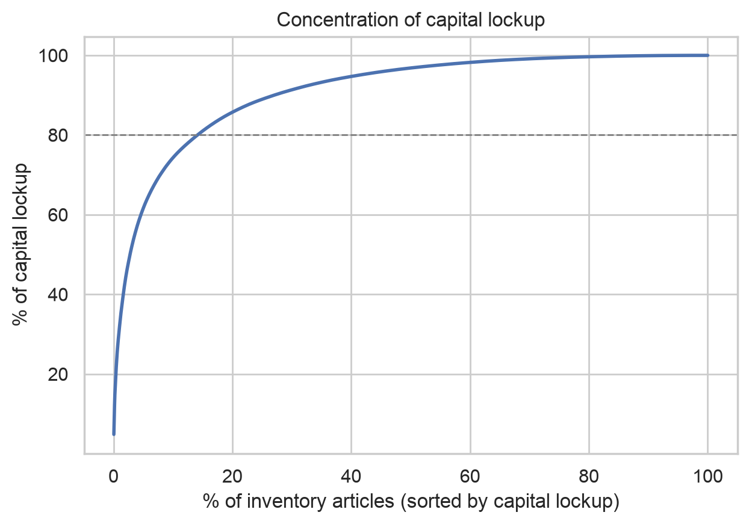
Concentrated in few, active articles – dead stock is a small lever
1 · WHERE IS THE CAPITAL?
74%
5%
of capital in the top 10% of stock articles
of capital in articles without demand for over a year
49%
401 d
in semi-finished parts (retail 36%, finished 12%)
coverage of C articles (A articles: 112 days)
Source: Notebook 03 §3, §4, §5, §7 · Report §4.2 and §4.4, p. 3–4
Notes:
PRESENTER: Colleague. Time: about 1.5 minutes. First answer: where does the capital sit? It is highly concentrated. The Pareto curve shows that the top 10 percent of stock articles hold 74 percent of the capital; the top 1 percent, 18 articles, already hold 31 percent. So a few decisions have a large effect. Second, and this surprised us: dead stock is small. The case slides suggest many articles have not moved for years, but in our data articles without any sale or usage for more than a year, plus those that never had demand, hold only about 5 percent of capital. 95 percent sits in articles that moved within the last year. The savings must therefore come from active articles that hold too much. Third, product type. The data have no such field, but the transactions reveal it: articles received from own production are finished products, articles mainly consumed in production are semi-finished, the rest is retail. Semi-finished parts hold 49 percent, retail 36 percent, finished products 12 percent. Fourth, the ABC analysis by consumption value: 169 A articles generate 80 percent of consumption and hold stock for 112 days; 959 C articles hold stock for 401 days. The ABC-XYZ matrix is in the report (Figure 2): 789 articles with low value and irregular demand hold 12 percent of capital.

Slide 5
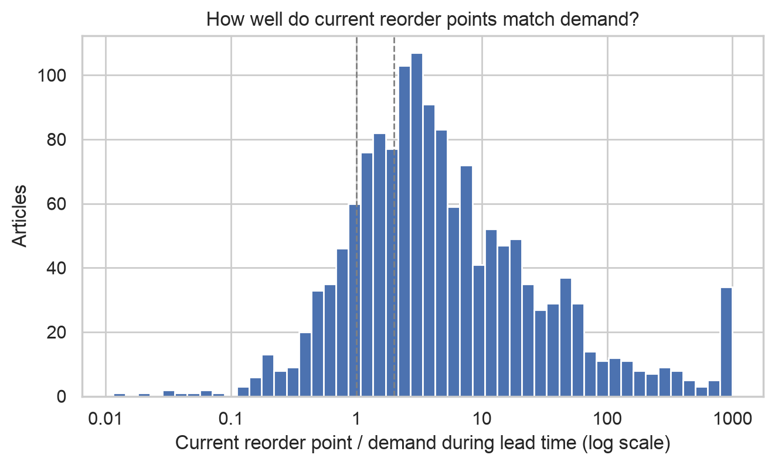
The excess comes from how much is ordered at once – not from when
KEY INSIGHT
57%
of stocked capital is not needed even by the company's own reorder points
91
articles have a reorder point below half the lead-time demand – yet hold 23% of capital
281
articles where one minimum order covers more than 12 months of demand
Source: Notebook 03 §9 · Notebook 05 §3 ("Ordering behaviour vs. reorder-point policy") · Report §4.4 p. 4, §6.3 p. 7
Notes:
PRESENTER: Colleague. Time: about 1.5 minutes. This is the heart of the story – take your time. The histogram compares each current reorder point with the demand during the lead time. A ratio of 1 means the reorder point exactly covers the lead-time demand. The reorder points are badly calibrated in both directions: 441 articles are more than ten times too high, but 91 articles are below half of what they need – and these 91 hold 23 percent of the capital. A low reorder point combined with high capital can only mean one thing: the stock comes from large order quantities. For 281 articles one minimum order covers more than a year of demand. We quantified this in the backtest, which Niko explains in a moment. For the simulated articles, actual capital lockup was 4.10 million. Following the company's own current reorder points, but ordering one month of demand or the MOQ each time, would need only 1.78 million. So 57 percent of the stocked capital lies beyond what the reorder-point policy requires. In that same replay, the current reorder points only reach a 74 percent fill rate – they are often too low. In reality the company did not run out because the excess stock covered the gaps. In short: the company bought availability with capital. Careful wording: 74 percent is not today's real availability, it is what today's reorder points deliver with disciplined order sizes. Handover: "So the problem is not only the parameters. But first we need to know which articles should be in stock at all – Niko."

Slide 6
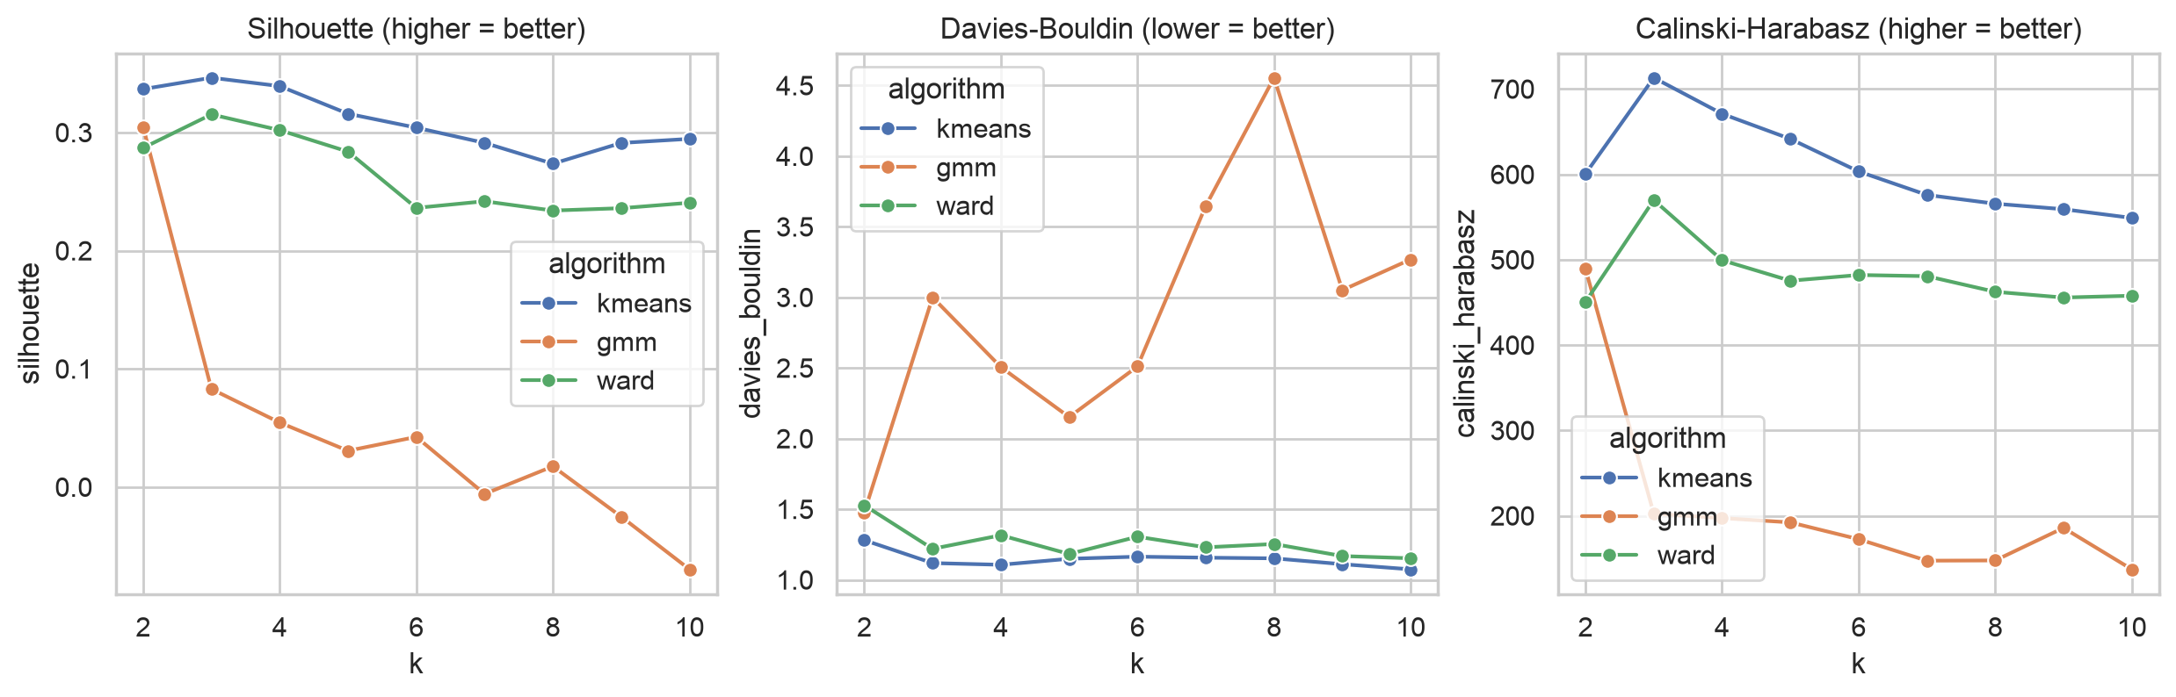
Clustering on what articles are, not on how they are managed today
2 · WHICH ARTICLES GO ON STOCK? · METHOD
Attributes
Feature selection
Algorithms
Evaluation
7 candidates, 1,498 articles. Today's lockup, reorder point and lead time excluded.
Correlation filter (CV dropped, r = 0.93), then forward selection by silhouette.
k-means, Gaussian mixture, Ward, k = 2–10. Best: k-means, k = 3.
Silhouette 0.346 · DB 1.12 · CH 713. Stability: ARI 0.98.
Final features
Consumption value · demand frequency (ADI) · demand size variability (CV²) · production share
Source: Notebook 04 §1–4 · Report §5.1–5.2, p. 4–5
Notes:
PRESENTER: Niko. Time: about 1.5 minutes. Question 2: which articles belong in stock at all? We follow the four steps the case suggests: relevant attributes, feature selection, algorithm, evaluation metric. Attributes: the clustering should describe the articles themselves, not the current policy we want to judge. So capital lockup, coverage, the current reorder point ratio and MOQ coverage are not inputs – that would be circular; we use them only afterwards to profile the clusters. Lead time is also excluded: it only takes a few standard values such as 30, 15 and 10 days, which would create artificial clusters, and it enters the safety stock formula anyway. That leaves seven candidates for the 1,498 articles with demand in 2019 to 2021, log-transformed where skewed and standardised. The 253 articles without demand form a separate class by rule, because frequency and variability are undefined for them. Feature selection in two steps: a correlation filter removed CV, which correlates at 0.93 with ADI. Then forward selection by silhouette, starting from a core of value, frequency and variability – the dimensions behind ABC and Syntetos-Boylan. It added production share; recency made the result worse and was rejected. Algorithms and evaluation: we compared k-means, a Gaussian mixture and Ward hierarchical clustering for k from 2 to 10. K-means with 3 clusters is best on silhouette and Calinski-Harabasz and close to best on Davies-Bouldin; the Gaussian mixture fails clearly. A silhouette of 0.35 is moderate, which is realistic for continuous article characteristics. The strongest argument is stability: re-clustering 30 random 80 percent samples reproduces the clusters with an adjusted Rand index of 0.98.

Slide 7
Four classes, four strategies
2 · WHICH ARTICLES GO ON STOCK? · RESULT
Class | Articles | Capital | Profile | Strategy
C1 Production components | 743 | 53% | 89% semi-finished, demand in 29 of 36 months, 149 days coverage | Stock, optimised safety stock and reorder point
C2 Sales articles | 474 | 39% | 55% retail, 44% finished, lumpy demand, 109 days coverage | Retail: stock, optimised. Finished: make-to-order
C3 Sporadic slow movers | 281 | 5% | Demand in 4 of 36 months, 3,949 days coverage, MOQ = 54 months | Order on demand, stop reordering
ND No demand | 253 | 3% | No sale or usage 2019–2021 | Phase out (71 new articles: observe)
On stock: C1 and C2 retail – 1,007 articles, 87% of capital. Within them, the ABC class sets the service level.
Source: Notebook 04 §5–6, Notebook 05 §1 · Report §5.3, p. 5
Notes:
PRESENTER: Niko. Time: about 1.5 minutes. The three clusters plus the rule-based class, numbered by capital. C1, production components: 743 articles with 53 percent of capital. 89 percent are semi-finished parts with regular demand, in the median 29 of 36 months. Production stops without them, so they stay in stock, but with corrected levels. C2, sales articles: 474 articles with 39 percent of capital, a mix of retail articles and own finished products with lumpier demand. Retail stays in stock with optimised levels. Finished products can be manufactured very fast on site, as the case says, so they are made to order instead of held in stock. C3, sporadic slow movers: 281 articles with demand in only 4 of 36 months. Their stock would last almost 11 years, and one minimum order covers 54 months of demand. Strategy: no more stock, order on demand and sell down. ND, no demand: 253 articles without any sale or usage from 2019 to 2021. They are phased out, except 71 articles introduced within the last year, which we observe. So the answer to the case question "which classes should be taken on stock": C1 and the retail part of C2, 1,007 articles holding 87 percent of the capital. The clusters decide whether an article is stocked; within the stocked articles, the ABC class decides how safely. Important consequence: 92 percent of capital sits in classes that stay in stock. The main lever is therefore the level, not removing articles – which brings us to question 3.

Slide 8
Reorder point = lead-time demand + safety stock
3 · HOW MUCH STOCK? · FORMULAS
Case study formula
Textbook comparison
SS = σ
ROP = D / 360 × L + SS
SS = z × σ × √(L / 30)
ROP = D / 360 × L + SS
No lead time maintained: SS = ROP = usage of last 12 months / 4
z = service level, set by ABC class. Longer lead time → bigger buffer.
Weakness: the buffer ignores lead time and the target service level.
Strength: service level becomes an explicit management choice.
σ = standard deviation of monthly demand 2019–2021 · D = annual demand · L = lead time in days · Order quantity Q = max(MOQ, one month of demand) · Expected average stock ≈ SS + Q/2
Source: Notebook 05 §2 · Report §6.1, p. 6
Notes:
PRESENTER: Niko. Time: about 1 minute. Question 3: how much stock should the stocked articles hold? The logic of a reorder point: it must cover the demand that arrives while we wait for a delivery – demand per day times lead time – plus a safety stock for uncertainty. The case gives a formula: safety stock equals the standard deviation of demand; the reorder point is annual demand divided by 360 times lead time, plus the safety stock. For the 37 articles without a maintained lead time, the case fallback applies: last 12 months of usage divided by four. Its weakness: the buffer ignores how long we wait and how safe we want to be. As a comparison we used the textbook formula: safety factor z times sigma times the square root of the lead time in months. A longer lead time means more can go wrong, so the buffer grows; z expresses the target service level, which we set by ABC class. Sigma is the standard deviation of monthly demand from 2019 to 2021 with outliers capped – monthly because daily business-to-business demand is mostly zeros. The order quantity is the larger of the MOQ and one month of demand, so the expected average stock is roughly safety stock plus half an order. Which formula is better is an empirical question, so we tested both.

Slide 9
Backtest: replaying 2021 day by day with real demand
3 · HOW MUCH STOCK? · EVALUATION
1
2
3
4
Real daily demand 2021 for 925 of 1,007 stocked articles
Serve demand from stock; unmet demand is lost
Position ≤ reorder point → order Q, arrives after lead time
Measure fill rate and average stock value
Out of sample: parameters from 2019–2020 only, tested on 2021.
Fair: same Q for every policy – only the reorder point differs.
Compared: current reorder points, case formula, textbook formula.
Source: Notebook 05 §3 · Report §6.2, p. 6 · Fill rate = share of demand (value-weighted) served directly from stock
Notes:
PRESENTER: Niko. Time: about 1 minute. A formula on paper proves nothing, so the evaluation metric for this step is a backtest simulation. For 925 of the 1,007 stocked articles we replay 2021 day by day with the real daily demand that happened. Each day demand is served from stock; what cannot be served counts as lost. Whenever the inventory position – stock on hand plus open orders – falls to the reorder point, we order the quantity Q, and it arrives after the lead time. At the end we measure the fill rate, the value-weighted share of demand served from stock, plus stockout days and the average stock value. 2020 is a warm-up year that is not measured. Two design choices make the test credible. First, it is out of sample: all parameters are estimated on 2019 and 2020 only, and tested on 2021, data the formulas have not seen. Second, it is fair: every policy uses the same order quantity, so the only difference is the reorder point. We compare three policies: the company's current reorder points, the case formula and the textbook formula. The 82 skipped articles had no demand before 2021, so they cannot be tested out of sample; they still get a recommendation from the full data.

Slide 10
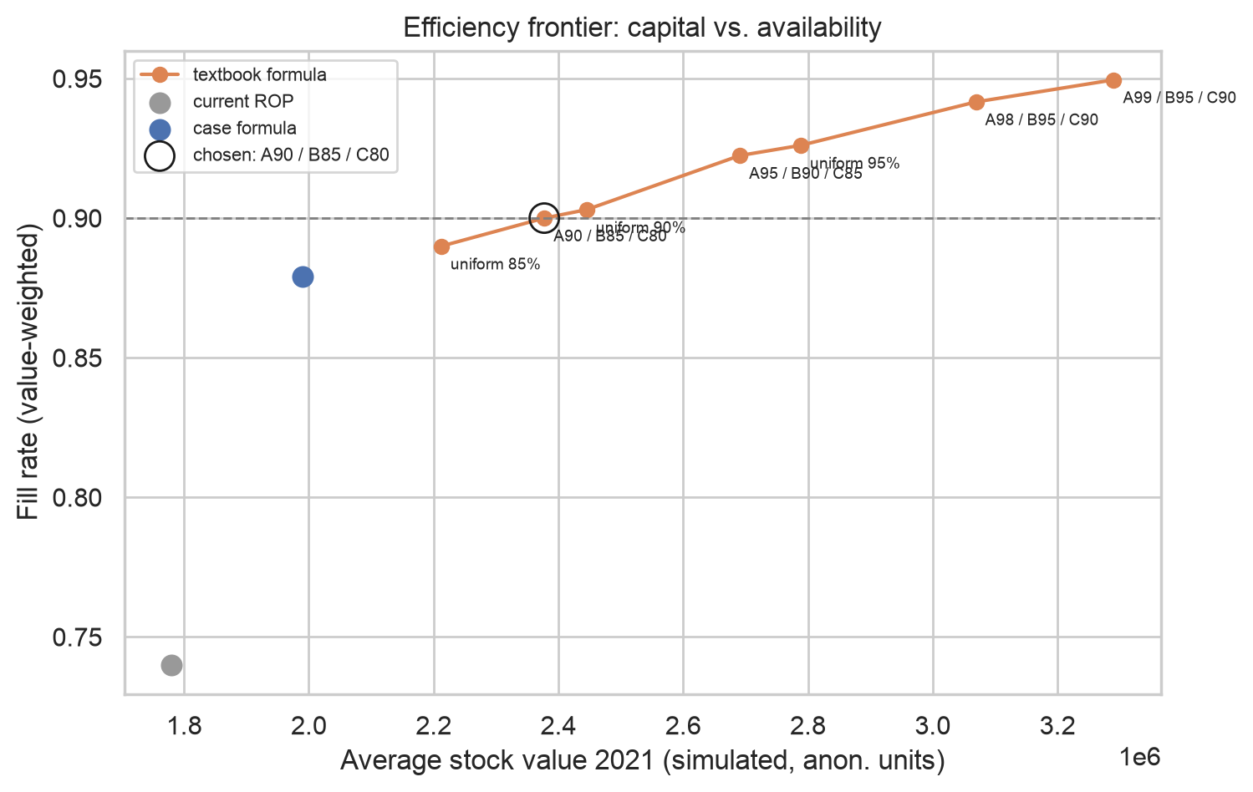
Efficiency frontier: the cheapest setting with ≥ 90% fill rate
3 · HOW MUCH STOCK? · CHOICE
Policy (2021) | Fill rate | Stock
Current reorder points | 74.0% | 1.78 M
Case formula | 87.9% | 1.99 M
Textbook A98/B95/C90 | 94.2% | 3.07 M
Chosen A90/B85/C80 | 90.0% | 2.38 M
ABC-differentiated levels beat a flat 90% (90.3% at 2.45 M). The case formula is close to the frontier – cheaper if 88% is enough.
Source: Notebook 05 §3 ("Efficiency frontier") · Report §6.2, p. 6, Figure 5
Notes:
PRESENTER: Niko. Time: about 1.5 minutes. Instead of fixing one service level up front, we simulated the textbook formula at seven service-level settings. Each orange dot is one setting: further right means more capital in stock, higher means more demand served. Together they form an efficiency frontier, the price of every extra point of availability. Reference points: the current reorder points reach only 74 percent fill rate at 1.78 million. The case formula reaches 87.9 percent at 1.99 million. The textbook formula with A 98, B 95, C 90 percent reaches 94.2 percent, but needs 3.07 million. Our selection rule was set before looking at the winner: the cheapest setting with at least 90 percent fill rate. That is A 90, B 85, C 80 percent: 90.0 percent at 2.38 million. Three observations. First, differentiating by ABC class is efficient: a flat 90 percent gives practically the same fill rate, 90.3 percent, but needs 2.45 million. Second, the simple case formula is surprisingly good in aggregate, almost on the frontier, because at the typical 30-day lead time one monthly sigma is roughly the right buffer. Its weakness is structural: it over-protects short lead times and under-protects long ones. We chose the textbook formula because the service level becomes an explicit dial for management; if 88 percent is acceptable, the case formula is the cheaper option, and we say so in the report. Third, B and C articles stay slightly below their nominal targets because lumpy demand is not normally distributed.

Slide 11
Chosen to cover every class and situation
RECOMMENDATIONS FOR TEN ARTICLES
Article | Situation | Strategy | Current ROP | New SS | New ROP | Capital | Fill rate
1425485 | C1, A, smooth, largest capital | Stock | 5,553 | 10,478 | 23,255 | −80% | 64→93%
1395542 | C2 retail, A, erratic | Stock | 13,328 | 16,953 | 35,218 | −18% | 52→89%
1424728 | C1, A, smooth | Stock | 1,332 | 4,205 | 7,891 | −81% | 65→90%
1333080 | C2 retail, A, lumpy | Stock | 59,980 | 23,409 | 42,500 | −71% | 100→91%
1412878 | C1, B, ROP > 10× lead-time demand | Stock | 2,665 | 87 | 248 | −78% | 100→100%
1423836 | C1, C, MOQ = 29 months of demand | Stock | 166 | 47 | 86 | −40% | 100→100%
1420466 | C1, C, no lead time maintained | Stock | 11 | 2 | 4 | −26% | 100→100%
1876926 | C2, finished, lumpy | Make-to-order | 111 | 0 | 0 | −100% | –
1334543 | C3, MOQ = 28 months of demand | Order on demand | 13,328 | 0 | 0 | −100% | –
1372564 | ND, no demand 2019–2021 | Phase out | 3,998 | 0 | 0 | −100% | –
Source: Notebook 05 §5 · outputs/tables/05_ten_articles.csv · Report §7, p. 7–9 · Fill rate: 2021 backtest, current → new reorder point
Notes:
PRESENTER: Niko. Time: about 1.5 minutes. The case asks for a recommendation per article; we agreed to work out ten in detail, chosen by rule so that together they cover every class and every typical situation: the largest capital holders, steady and lumpy demand, an MOQ-driven article, an oversized reorder point, an article without a maintained lead time, and one article for each strategy without stock. The full list for all 1,751 stock articles is in the Excel file. How to read the table: current ROP is the company's safety stock field, which it uses as the reorder point. New SS and new ROP are our textbook values with the chosen service levels. Capital compares the expected new capital (safety stock plus half an order, times price) with the last 12 months. Fill rate is from the 2021 backtest. Three patterns to point out. First, the three largest articles (1425485, 1395542, 1424728) all have reorder points that are too low – fill rates of 52 to 65 percent – yet capital falls because we order one month at a time. Second, 1412878 is the opposite case: a reorder point more than ten times too high, cut from 2,665 to 248 with no simulated stockout. Third, 1423836 and 1334543 show the MOQ problem: one minimum order covers 28 or 29 months of demand, so the real lever is renegotiating the MOQ or using the second supplier. 1333080 is the honest trade-off: lumpy demand from large customer orders. Capital falls by 71 percent, but fill rate drops from 100 to 91 percent. For such searched demand we recommend coordinating large orders with customers rather than holding a big buffer. 1420466 has no lead time maintained; the case fallback gives a reorder point of about 7, the textbook variant with an assumed 30 days gives 4. Our main recommendation there is to maintain the real lead time.

Slide 12
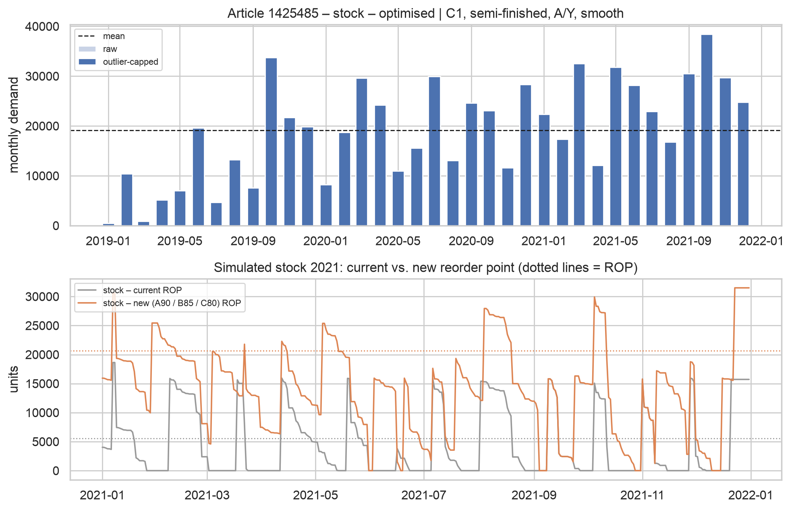
Reorder point up, capital down 80%
ONE ARTICLE IN DEPTH · 1425485
Production part · ≈ 19,000 units/month · lead time 20 days → ≈ 12,800 units needed while waiting
 | Today | New
Reorder point | 5,553 | 23,255
Order size | bulk | 1 month
Fill rate 2021 | 64% | 93%
Capital | 241 k | 47 k
The whole project in one article: the problem is the order size, not only the reorder point.
Source: Notebook 05 §5 (figure 05_article_1425485.png) · Notebook 03 §3 (top 15) · Report §7, p. 7–8, Figure 6
Notes:
PRESENTER: Niko. Time: about 1 minute. If the audience remembers one article, it should be this one, the largest capital holder. It is a production part with steady demand of about 19,000 units per month (top chart) and a lead time of 20 days, so production needs about 12,800 units while a delivery is on its way. The current reorder point is 5,553, less than half of that. The bottom chart shows the 2021 replay: with the current reorder point (grey) stock regularly hits zero, fill rate 64 percent. With the new reorder point (orange) it rarely does, fill rate 93 percent. Note: the dotted line in the chart is at about 20,600 because the backtest uses parameters from 2019–2020 only; the recommendation of 23,255 uses all three years. But in reality, the company held about 100,000 units on average – more than five months of demand – because it ordered huge quantities at once. Our recommendation does two things: raise the reorder point to 23,255, and order about one month of demand each time. Expected capital falls from 241 thousand to 47 thousand anonymised units, minus 80 percent, while availability rises. So the reorder point goes up and capital goes down at the same time. That is the whole project in one article. Handover: "What does this add up to across all articles? Back to [colleague]."

Slide 13
Half the capital, better availability
RESULT
−55%
Strategy | Articles | Capital
Stock, optimised | 1,007 | 4.35 → 2.18 M (−50%)
Make-to-order | 210 | 0.23 M → 0
Order on demand | 281 | 0.23 M → 0
Phase out | 182 | 0.09 M → 0
Observe (new) | 71 | unchanged
capital lockup, 4.96 M → 2.23 M (anonymised units)
74% → 90%
fill rate in the 2021 backtest
Plus MOQs cut to one month of demand: about −63%. Savings arrive as existing stock is used or sold.
Source: Notebook 05 §4 ("Capital lockup effect", "Order-size lever") · Report §1 p. 2, §6.3 p. 7
Notes:
PRESENTER: Colleague. Time: about 1 minute. What does it add up to? Capital lockup of the 1,751 stock articles falls by 55 percent, from 4.96 to 2.23 million anonymised units, while the fill rate in the 2021 backtest rises from 74 to 90 percent. The largest part comes from the 1,007 articles that stay in stock: with the new safety stocks and reorder points and ordering about one month of demand, their capital halves, from 4.35 to 2.18 million. The rest comes from articles that leave stock: 210 finished products made to order, 281 slow movers ordered on demand, 182 articles without demand phased out. The 71 new articles are unchanged. Two cross-checks agree: the formula estimate for the stocked articles and the day-by-day simulation give similar values (2.18 versus 2.38 million on the simulated subset). An additional lever is the minimum order quantity: if MOQs were reduced to one month of demand, the reduction would reach about 63 percent. Two honest caveats: the savings are not immediate – they materialise as existing stock is consumed or sold – and because the data are anonymised, only the percentages are meaningful.

Slide 14
What the company should do – and what to keep in mind
RECOMMENDATIONS, LIMITS AND OUTLOOK
Recommendations
Apply the class-based stocking policy
Order defined quantities (≈ 1 month) at the reorder point – end bulk buying
Renegotiate MOQs or use the second supplier (281 articles > 1 year)
Set service levels by ABC class as a management decision
Measure real lead times; maintain the 37 missing ones
Coordinate large, lumpy orders with customers
Recalculate classes and levels quarterly
Limits
Anonymised data – only percentages
Master data are today's snapshot
Stock-series breaks – robustness check passed
Simplified backtest: fixed Q and lead time, lost sales
Normal-distribution buffers fit lumpy demand poorly
Outlook
Croston forecasting for intermittent demand, stochastic lead times, cost-based order quantity, validation on original data
Source: Report §8 and §9, p. 9–10
Notes:
PRESENTER: Colleague. Time: about 1.5 minutes. Seven recommendations. One: implement the class-based stocking policy – stock C1 and C2 retail, make finished products to order, order C3 on demand, phase out articles without demand. Two, the biggest lever: fix ordering behaviour. When the reorder point is reached, order a defined quantity, about one month of demand, and end the precautionary bulk buying of the Covid period. Three: renegotiate minimum order quantities, or use the second supplier – the case says every article has at least two; for 281 articles one order covers more than a year. Four: set service levels by ABC class and treat them as an explicit management decision; the frontier shows the cost of every extra point. Five: measure real lead times from order and receipt dates – today they are rounded standard values, and 37 stock articles have none. Six: plan searched demand together with large customers. Seven: rerun classification and levels every quarter. Limits, briefly: the data are anonymised; master data are today's snapshot, so historical reorder points are unknown; the stock series has day-level breaks, but a second calculation method gave the same conclusions; the backtest simplifies with fixed order quantities, fixed lead times and lost sales; and the buffer formulas assume normally distributed demand, which does not hold for lumpy articles. 2021 also still contains Covid effects. Outlook: forecasting per class, for example Croston's method for intermittent demand; stochastic lead times; an order quantity based on ordering and holding costs; and validation with the original data. Close: "Thank you – we are happy to take questions." (Backup slides follow.)

Slide 15
Thank you – questions?
Backup: robustness of the stock series · cluster profiles · method details
Code, figures and report: github.com/Niko-Geo/inventory-management-hslu
Notes:
Show this slide during questions. The three backup slides that follow answer the most likely technical questions: whether the stock-level glitch changes the results, what the clusters look like in detail, and the exact rules and thresholds used.

Slide 16
The stock-series breaks do not change the conclusions
BACKUP · DATA QUALITY
Within each day the stock series is 100% consistent. But 51% of day-to-day transitions jump – and positive and negative jumps almost cancel out (+365 M / −368 M).
Year | Reported | Rebuilt | Diff.
2016 | 1.76 M | 2.00 M | +13%
2017 | 2.60 M | 2.50 M | −4%
2018 | 3.51 M | 3.77 M | +7%
2019 | 3.78 M | 3.60 M | −5%
2020 | 4.17 M | 4.59 M | +10%
2021 | 4.94 M | 5.24 M | +6%
Check: rebuild stock from cumulated quantities and compare capital lockup.
Per-article correlation 0.95. We use the reported levels – the lower, more conservative baseline.
Source: Notebook 02 §A4, Notebook 03 §1 and §2b · Report §3 ("Stock level series"), p. 3
Notes:
Likely question: "Can you trust the stock levels?" The stock field holds the level before each transaction. Within a day the series is fully consistent. Between days, 51 percent of transitions show a jump, and the positive and negative jumps sum to almost the same amount, so they cancel out. They do not cluster on year-end or stocktake dates, and they grow with transaction volume, which points to booking-order or dating effects, or the anonymisation. To test whether it matters, we rebuilt the stock a second way, from cumulated quantities anchored at the last reported stock. Yearly capital lockup differs by only minus 5 to plus 13 percent, the trend is identical, and per article the two methods correlate at 0.95 over the last 12 months. So the conclusions do not depend on the issue. We kept the reported levels because they give the lower capital figure, which keeps our savings estimate conservative.

Slide 17
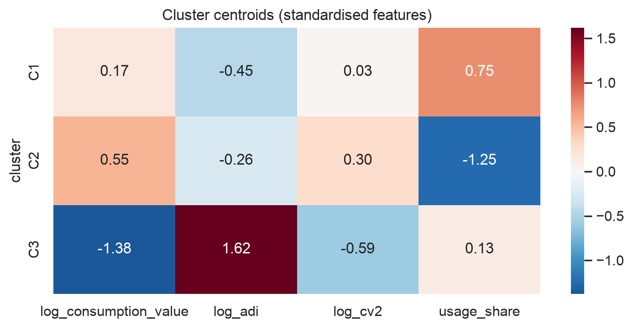
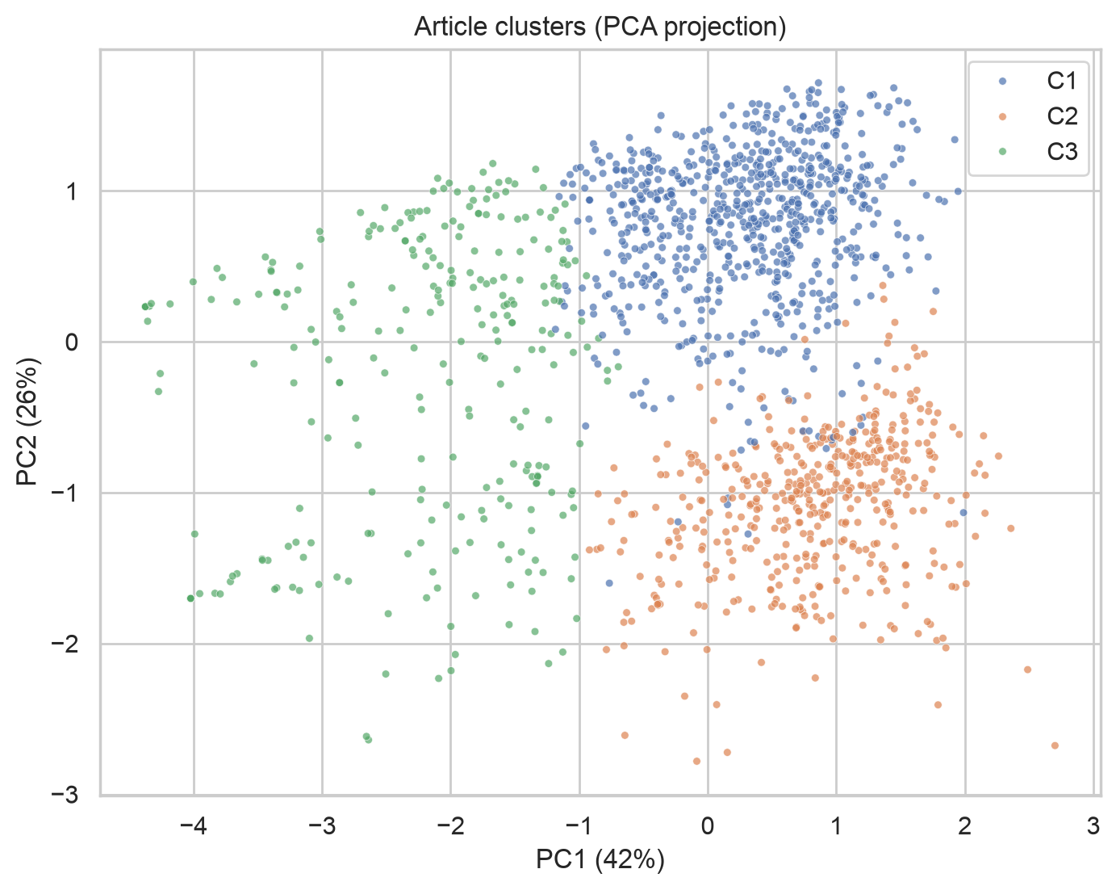
What separates the clusters
BACKUP · CLASSIFICATION
Agreement with classic schemes (adjusted Rand index): ABC 0.06 · XYZ −0.04 · Syntetos–Boylan 0.07 · product type 0.45 – the clusters add the article's role to its demand behaviour.
Source: Notebook 04 §4–5 (figures 04_cluster_centroids.png, 04_clusters_pca.png) · Report Appendix B, p. 11
Notes:
Likely questions: "What do the clusters actually look like?" and "Isn't this just ABC-XYZ again?" Left: the cluster centroids on the standardised features. C1 has high production share and frequent demand; C2 has low production share, meaning sales articles; C3 has very infrequent demand and low consumption value. Right: the articles projected on the first two principal components; the first component is mainly value versus frequency, the second mainly production share. Agreement with the classic schemes is near zero for ABC, XYZ and the Syntetos-Boylan patterns, and moderate for product type (0.45), because production share is one of the four features. So the clusters are not a re-labelling of ABC-XYZ: they combine what role an article plays with how it is demanded.

Slide 18
Rules and thresholds
BACKUP · METHOD DETAILS
Step | Rule
Reference date | 21.01.2022; demand window 2019-01 to 2021-12 (36 months, zero months included)
Outliers | Demand transaction > 10× the article's median and no other ≥ 50% of its size; capped, never removed
Product type | Finished = receives own production · semi-finished = usage ≥ 50% of demand · else retail
ABC | Consumption value, last 12 months: A ≤ 80%, B ≤ 95%, C rest, N none
Demand pattern | Smooth: ADI < 1.32 and CV² < 0.49 · erratic · intermittent · lumpy (Syntetos–Boylan)
Clustering | Standardised features, k-means (50 starts), k in 3–8 by silhouette, every cluster ≥ 3%
Service levels | Chosen z: A 1.28 (90%), B 1.04 (85%), C 0.84 (80%)
Backtest | 2020 warm-up, 2021 measured; start stock = ROP + Q/2; missing lead time → group median
Source: src/config.py · Notebooks 02–05 · Report Appendix A, p. 11
Notes:
Use only if asked about a specific threshold. All values are set in src/config.py or at the top of the relevant notebook cell, and listed in Appendix A of the report. ADI is the average interval between months with demand (1 = every month); CV squared is the squared coefficient of variation of non-zero monthly demand sizes. The service-level z values are the normal quantiles for 90, 85 and 80 percent cycle service level.

